Slide 1
LAB#A-2 Design Analysis
109061806 羅允辰
Github Link: https://github.com/jasonlo0509/DCT_HLS_Optimization

Slide 2
Outline
Objective
5 Optimizations (Pragmas)
Inner-loop Pipelining
Critical Outer-loop Pipepining
Array Partitioning
Apply Dataflow (Inter-Function Pipelining)
Inline (Apply Dataflow to Sub-Funtion)
Result

Slide 3
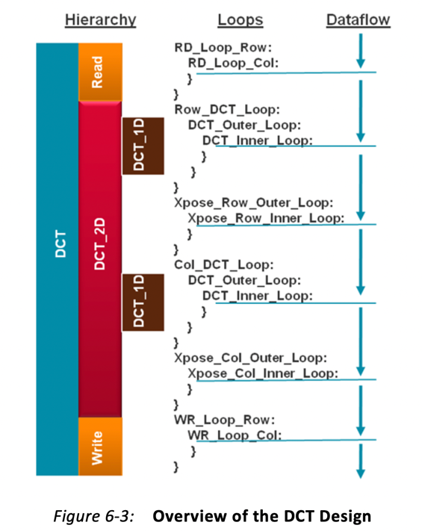
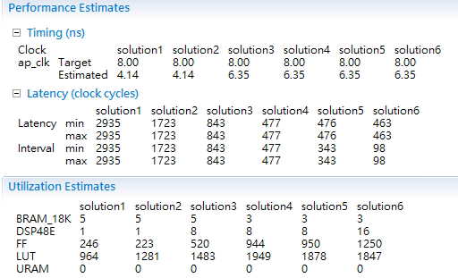
Objective
目標：
用 Vivado HLS 分析並將 DCT
優化成每 100 cycles 內可以吃下一筆資料

Slide 4
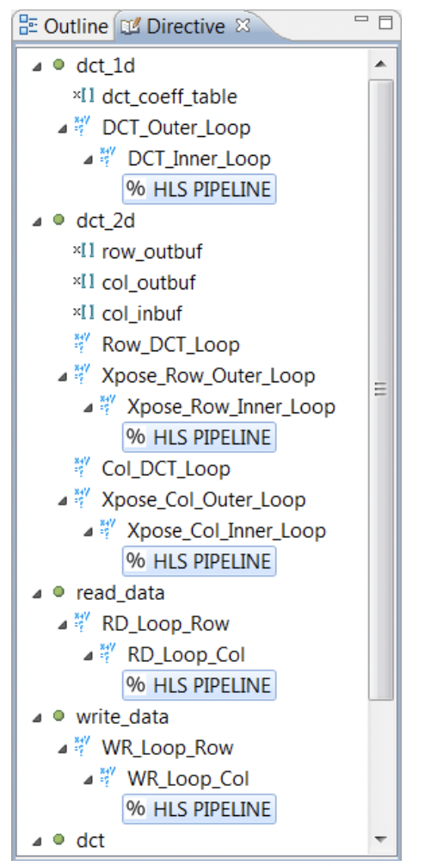
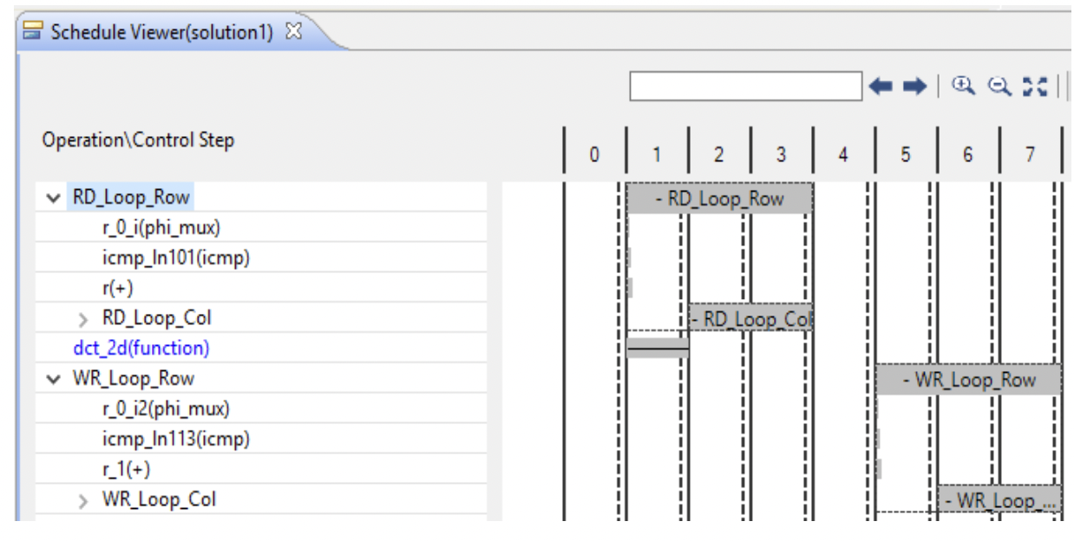
Opt1- Inner Loop Pipelining

Slide 5
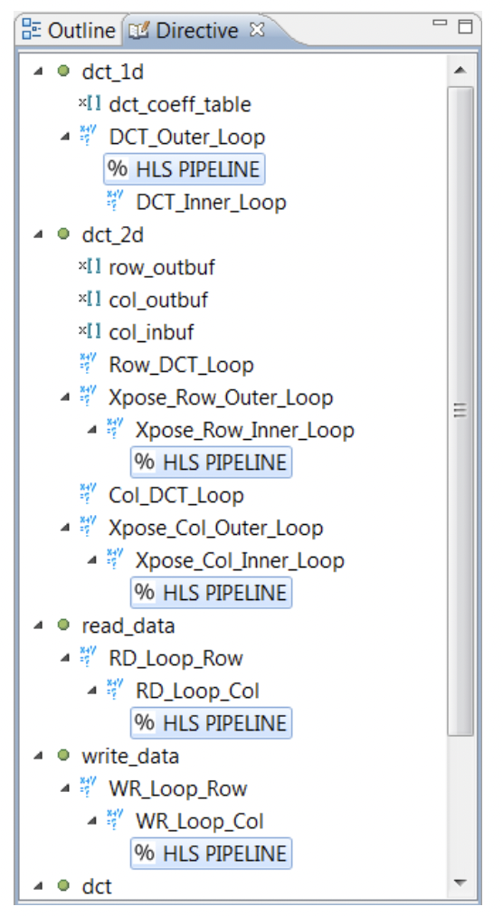
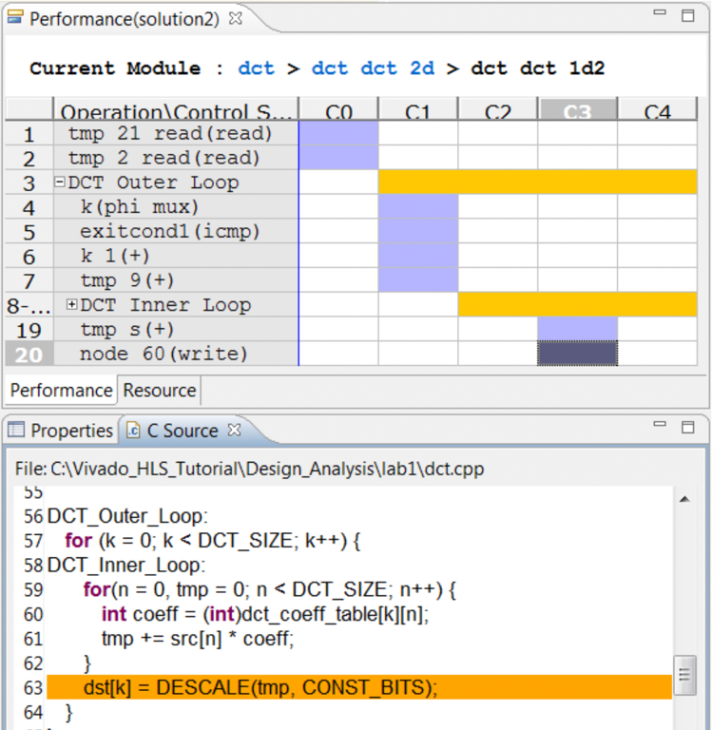
Opt2- Critical Outer Loop Pipelining

Slide 6
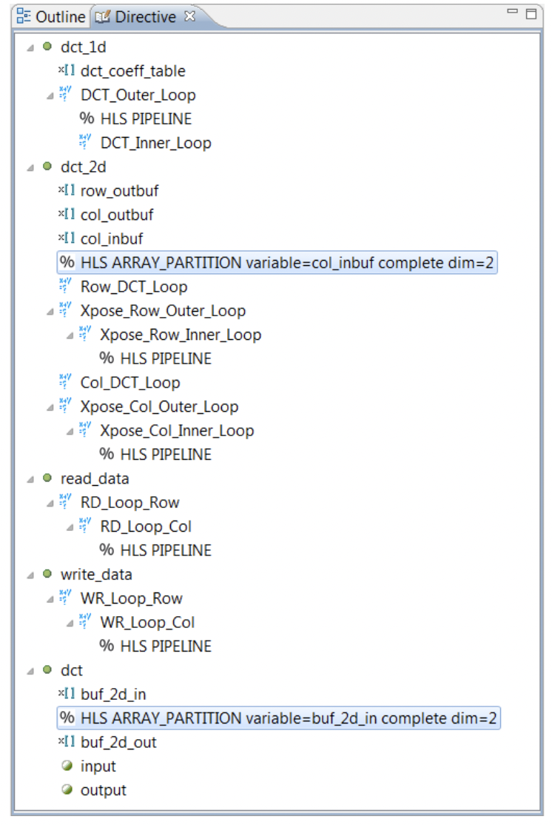
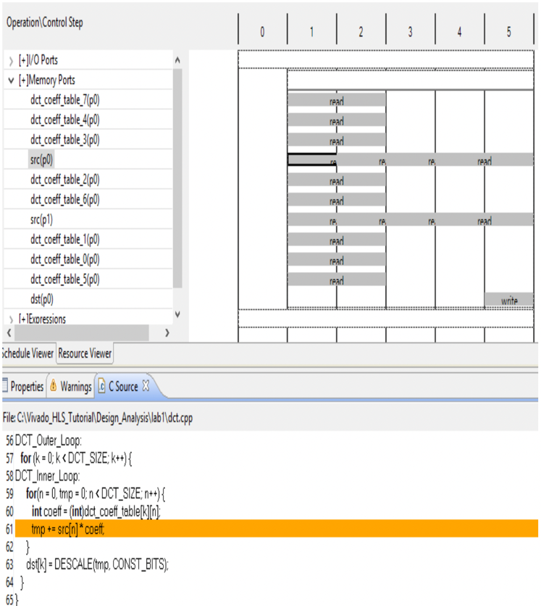
Opt3-Array Partitioning

Slide 7
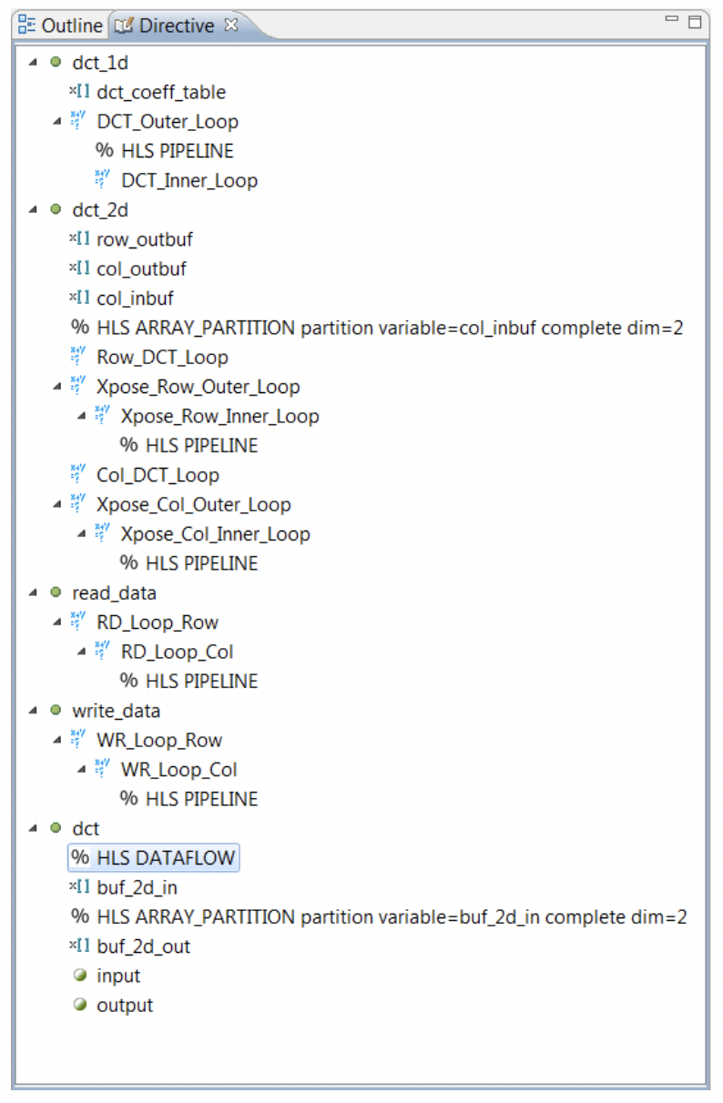
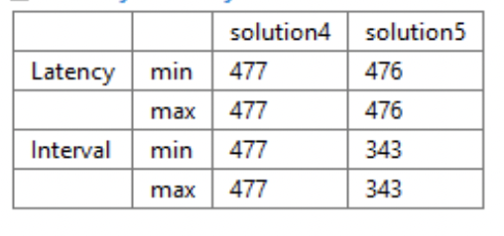
Opt4-Apply Dataflow

Slide 8
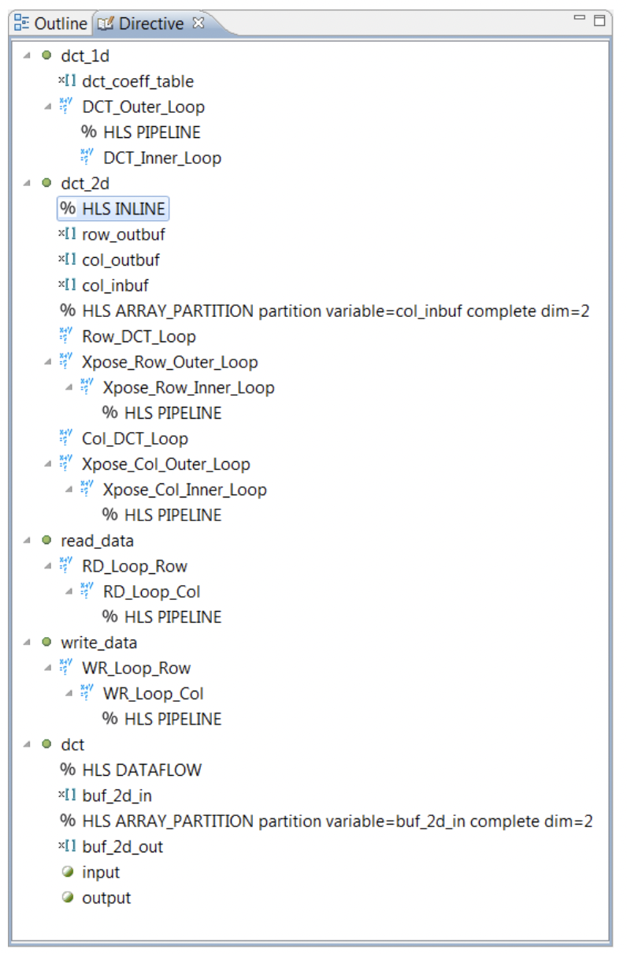
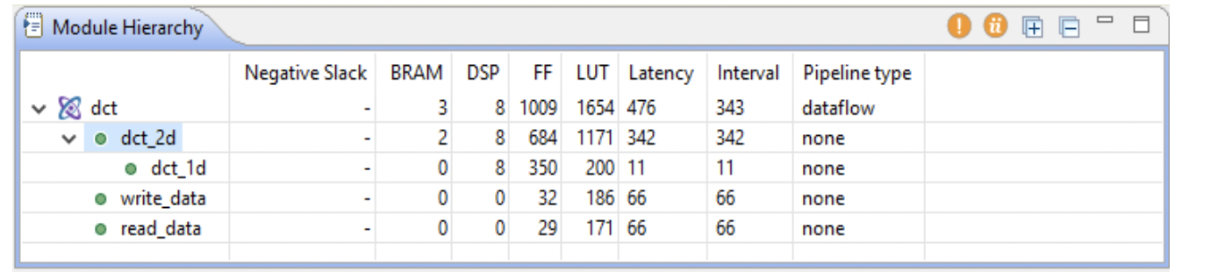
Opt5-Inline (Apply Dataflow to Sub-Funtion)

Slide 9
Result
目標：
用 Vivado HLS 分析並將 DCT
優化成每 100 cycles 內可以吃下一筆資料
每 98 cycles可以
灌下一筆資料
成功！

